Slide 1
LAO LOGISTICS LAO Distribution Footprint
28 Feb

Slide 2

LAO Distribution Footprint
LAO:
34 Warehouses
North:​
7062 - Tocancipa DC- Colombia
7081 -Las Brisas – Costa Rica
7093 – CD Panamá
7088 - CD Guatemala
7067 - PDC - Colombia
7078 /7351 - Coris DC
7353 – HUB
7151 - Puerto Rico DC
7063 -Barbosa DC - KCP
7040 - Perimetral DC - Ecuador
7091 - San Pedro Sula DC - Honduras
7100 - Tegucigalpa DC - Honduras
7084/7085/7354 - Sitio del Niño DC – El Salvador
*
Brazil:
7026 - CDMA – Brasil
7028 -CD Mogi
7320 - Suzano DC
7323 - Camacari DC
7324 - CD Aruja
7322 - CD Cachoerina
7033 - CD KCP RECIFE
7034 - CD KCP FORTALEZA
7026/ 7320 - SUZANLOG LOGISTICA LTDAg
*
*
Andes
7172 – Huachipa - Perú
7048 - Puente Piedra DC - Perú
7046 - Santa Clara DC - Peru
7037 - La Paz DC - Bolivia
7038 - Scott SCZ DC - Bolivia
7015 - Santiago Mill – Chile
7215 - Santiago DC - Chile
*
South:
7235 - El Bagual - Argentina
7003 - Pilar DC - Argentina
7044 - San Luis DC - Argentina
7011 - Costa Oriental DC – Paraguay
7018 - Uruguay DC - Uruguay

Slide 3


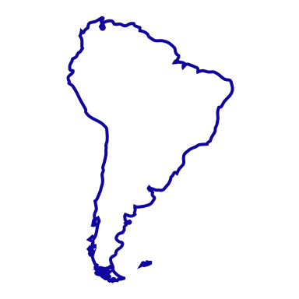




LAO Distribution Footprint
Jan 2023
Warehouses Operations
Warehouses location
North LAO
34 sites
Brazil
7 sites
13
Warehouses
DCs
7 site
6 sites
9
DCs
Mill Wareh.
2 sites
2 sites
Mill Wareh.
Andes
5
2 site
South Cone
DCs
6
3 sites
4 site
DCs
Mill Wareh.
2 sites
Mill Wareh.

Slide 4


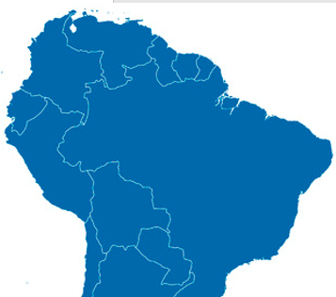





WH Operations– Current State
Manage by
Mill Operation
Warehouses location
KC Warehouses
3PL Warehouses
Andes
2 site
DCs
3 site
Mill Wareh.

